Slide 1
Gradebook GUI
Limas Nursalim

Slide 2
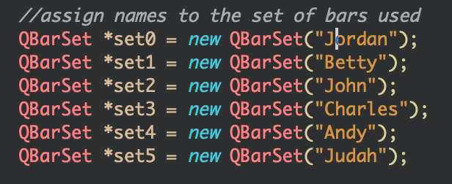
QBarset
The QBarSet class represents one set of bars in a bar chart.

Slide 3
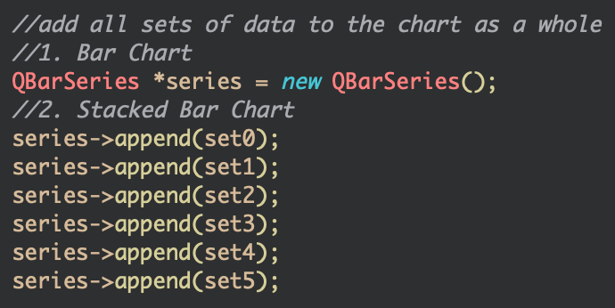
qbarseries
The QBarSeries class presents a series of data as vertical bars grouped by category.

Slide 4
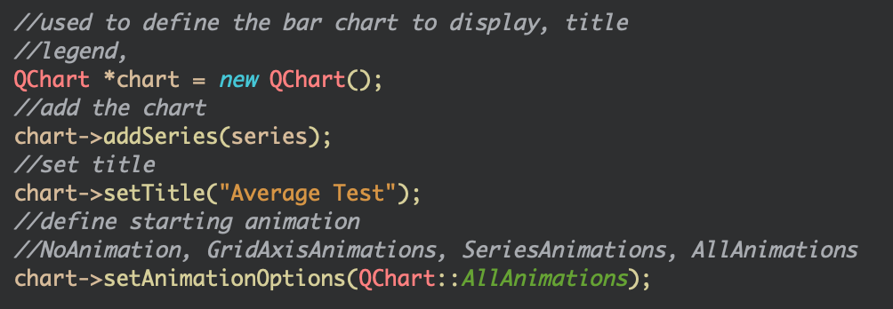
QChart
TheQchart class manages the graphical representation of the chart's series, legends, and axes.

Slide 5
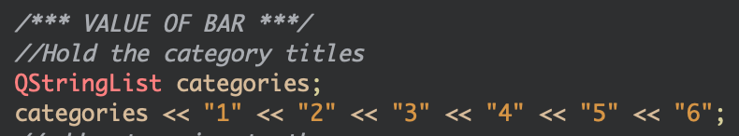
Qstringlist
The QStringList class provides a list of strings.

Slide 6
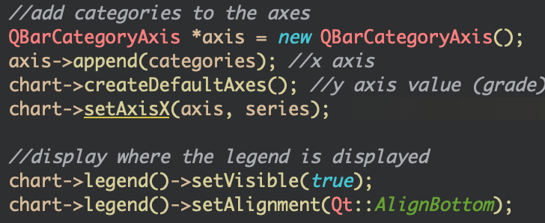
QBarcategoryaxis
The QBarCategoryAxis class adds categories to a chart's axes.

Slide 7
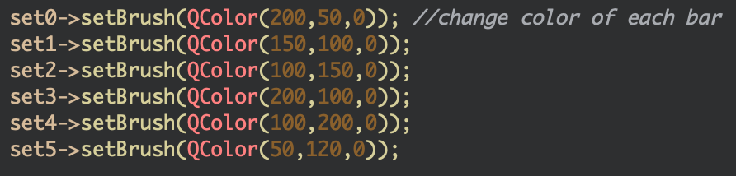
qcolor
The QColor class provides colors based on RGB, HSV or CMYK values.

Slide 8
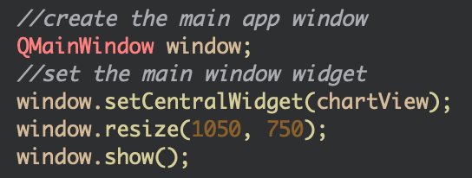
qMainwindow
The QMainWindow class provides a main application window.

